Slide 1

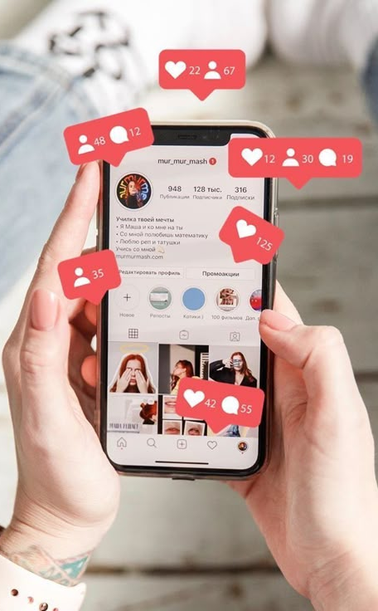




Influencer Marketing ROI

Slide 2

Group : DATA HUNTERS
1.Sevinc Qiyasova
2.Zəhra Abdullayeva
3.Ziyafət Rzayeva
4.Ülvi Yunis
5.Ayşad Namazov

Slide 3
What is ROI?
ROI (Return on Investment) is an indicator that measures how much profit an investment generates. It is calculated as the ratio of profit obtained to the costs incurred and is expressed as a percentage. A high ROI indicates that the invested funds have been used more efficiently.

Slide 4
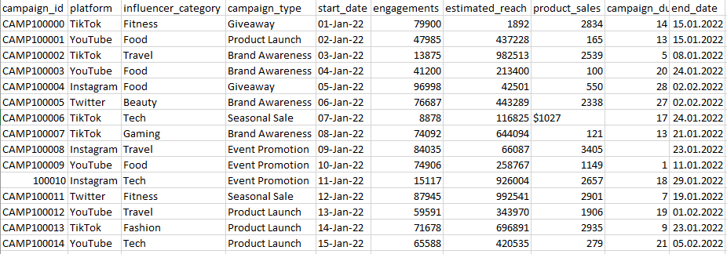
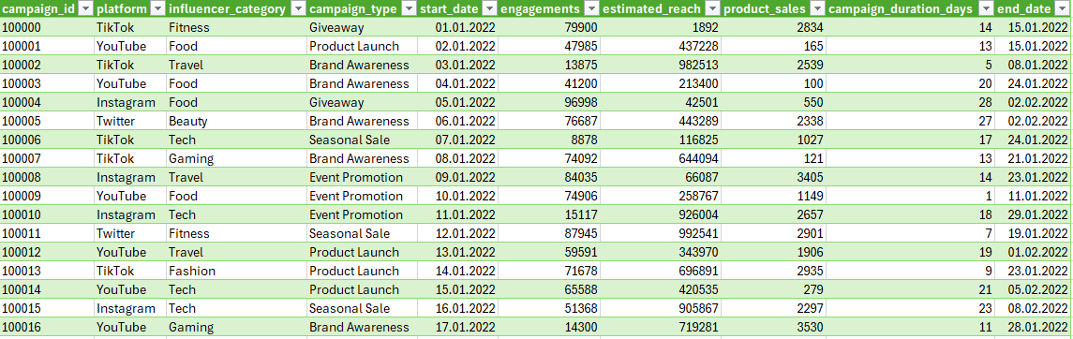
Step 1
Data Cleaning

Slide 5
Step 2
1.Sales efficiency by category
2.Engagement per Category
3.Count of Campaign per Platform
4.Sales, Reach and Engagement by Platform (ROI)
5.Platform vs Campaign Sales
6.Engagement rate by campaign days
7.Monthly performance
Data Analysis

Slide 6
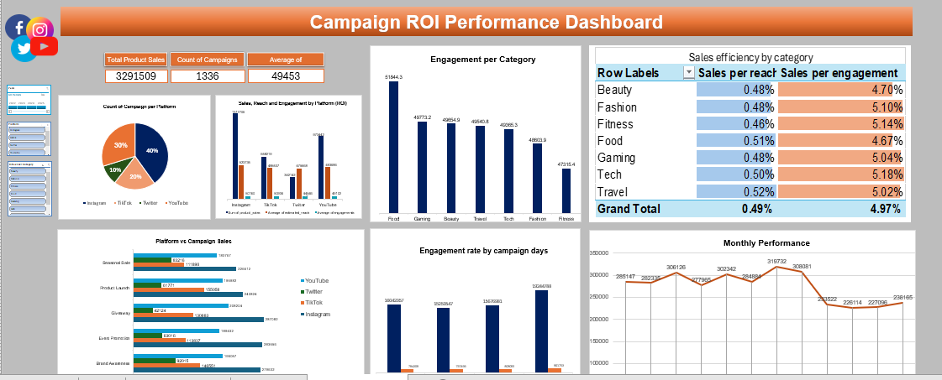
Dashboarding
Step 3

Slide 7
Step 4
1.For the fitness target audience – Reaching a wider audience.
2.For Food & Beauty – Short Q&A sessions, polls, showcasing product usage in live streams. Posts with discount codes.
3.A balanced testing strategy should be developed across platforms.
4.In other weaker campaigns:
-CTA (Call-to-Action)
-Visual interactivity
5.To increase follower engagement during the summer season, motivational campaigns should be carried out.
6.Longer advertising duration = more sales
Conclusion and Recommendations

Slide 8
Thank you for your attention!
Please keep this slide for attribution

